Slide 1
Basic Statistical Concepts
Presented by:
Samiran Mandal,
NITTTR, Kolkata

Slide 2
What is statistics?
Statistics is a science dealing with the collection, analysis, interpretation, and presentation of numerical data.

Slide 3
What is population?
Population is a collection of persons, objects, or items of interest.
Example:
All Ford Mustang cars produced in 2008 to 2010.
All workers presently employed by Microsoft.

Slide 4
What is Census?
The researcher defines the population to be whatever he or she is studying. When researchers gather data from the whole population for a given measurement of interest, they call it census.

Slide 5
What is sample?
A sample is a portion of the whole and, if properly taken, is representative of the whole. For various reasons researchers often prefer to work with a sample of the population instead of entire population.
Example: In conducting quality control experiments to determine the average life of light bulbs, a light bulb manufacturer might randomly sample only 75 light bulbs during a production run. Because of time and money limitations, a human resources manager might take a random sample of 40 employees instead of using a census to measure company morale.

Slide 6
What is descriptive statistics?
If a researcher is using data gathered on a group to describe or reach conclusions about the same group, the statistics are called descriptive statistics.
Example: If an instructor produces statistics to summarize a classes examination effort and uses those statistics to reach conclusions about the class only, the statistics are descriptive.

Slide 7
What is inferential statistics?
If a researcher gathers data from a sample and uses the statistics generated to reach conclusions about the population from which the sample was taken, the statistics are inferential statistics.

Slide 8
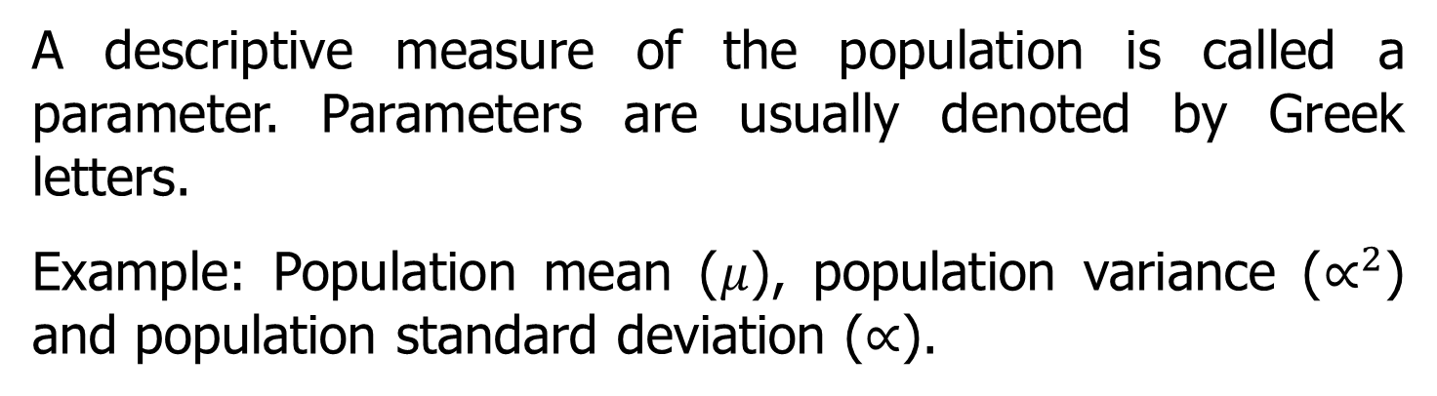
What is parameter?
A descriptive measure of the population is called a parameter. Parameters are usually denoted by Greek letters.
Example: Population mean ($μ$), population variance ($∝^{2}$) and population standard deviation ($∝$).

Slide 9
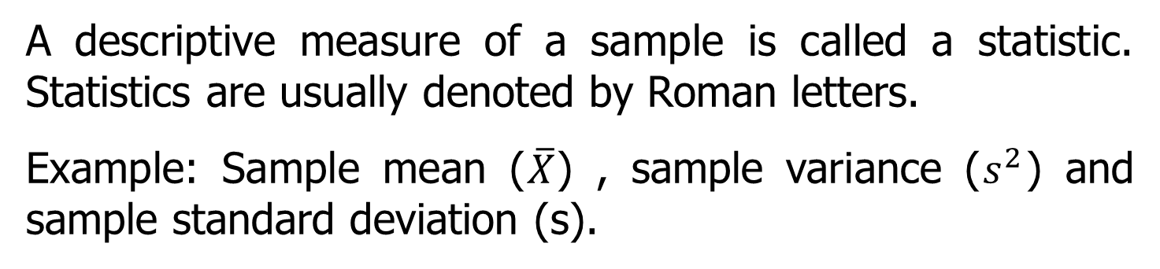
What is statistic?
A descriptive measure of a sample is called a statistic. Statistics are usually denoted by Roman letters.
Example: Sample mean ($\overline{X}$) , sample variance ($s^{2}$) and sample standard deviation (s).

Slide 10
What is a variable?
A variable is a characteristic of any entity being studied that is capable of taking different values.
Example: Return on investment, labor productivity, total sales, age of worker, time spent in store shopping.

Slide 11
Variables
variable…
any observation that can take on different values
attribute…
a specific value on a variable

Slide 12
Examples
Variable | Attribute
age

Slide 13
Examples
Variable | Attribute
age | 18, 19, 20, etc...

Slide 14
Examples
Variable | Attribute
Gender or sex

Slide 15
Examples
Variable | Attribute
Gender or sex | Male, female

Slide 16
Examples
Variable | Attribute
satisfaction

Slide 17
Examples
Variable | Attribute
satisfaction | 1 = very satisfied
 | 2 = satisfied
 | 3= somewhat satisfied
 | 4 = not satisfied
 | 5 = not satisfied at all

Slide 18
What is measurement?
A measurement is when a standard process is used to assign numbers to particular attributes or characteristics of a variable.
Some measurements are obvious, such as time spent in a store shopping by a customer, age of the worker. However some measurements, such as labor productivity, customer satisfaction and return on investment, have to be defined by the researcher or by expert in the field.

Slide 19
What is data?
Data are recorded measurements. It is data that are analyzed by statistician in order to learn more about variables being studied.

Slide 20
What is level of data measurement?
All data should not be analyzed the same way statistically because the entities represented by the numbers are different. For this reason researcher needs to know the bend of data measurement.

Slide 21
What are the common levels of data measurement?
Four common levels of data measurement are
Nominal.
Ordinal.
Interval.
Ratio.

Slide 22
What is nominal level?
The lowest level of data measurement is nominal level. Number representing nominal level data can be used only to classify or categorize.
Example: Which of the following employment classification best describes your area of work?
Educator.
Construction worker.
Manufacturing worker.
Lawyer.
Doctor.
Other.
Suppose that, for computing purposes, an educator is assigned 1, a construction worker a 2, and so on.
Here : 1 + 2 ≠ 3
(Educator + Construction worker ≠ Manufacturing worker)

Slide 23
What is ordinal level?
Ordinal level data measurements higher than the nominal level. In addition to the nominal level capabilities, ordinal level measurement can be used to rank objects.
Example: The computer tutorial is
Not helpful somewhat helpful moderately helpful very helpful extremely helpful
1 2 3 4 5

Slide 24
What is interval data?
Interval level data measurement is the next to the highest level of data in which the distances between consecutive numbers have meaning and the data are always numerical.
The distances represented by the differences between consecutive numbers are equal; that is interval data have equal intervals.
Example: Interval measurement is Fahrenheit temperature with Fahrenheit temperature numbers, the temperatures consecutive readings, such as 20°, 21° and 22° are the same.

Slide 25
What is ratio level?
Ratio level measurement is the highest measurement. Ratio data have the same properties as interval data, but ratio data have an absolute 0, and the ratio of two numbers is meaningful.
The motion of absolute zero means that zero is fixed, and the zero value in the data represents the absence of the characteristic being studied.

Slide 26
What is ratio level?
Example: Height, weight, time, kelvin temperature with ratio data, a researcher can state that 180 pounds of weight is twice as much as 90 pounds or in other words, make a ratio of 180:90. Many of the data by machines in industry are ratio data.
Other example: Production cycle time, work measurement time, passenger miles, number of trucks sold, complaints per 10, for fillers.

Slide 27
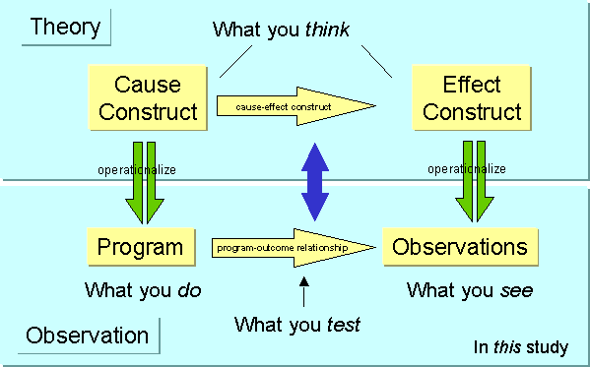

Slide 28
The Validity Questions Are Cumulative...

Slide 29
The Validity Questions Are Cumulative...
In this study
Is there a relationship between the cause and effect?

Slide 30
The Validity Questions Are Cumulative...
In this study
Is the relationship causal?
Is there a relationship between the cause and effect?
Conclusion

Slide 31
The Validity Questions Are Cumulative...
In theory
Can we generalize to the constructs?
Internal
Is the relationship causal?
Conclusion
Is there a relationship between the cause and effect?

Slide 32
The Validity Questions Are Cumulative...
Can we generalize to other persons, places, times?
In theory
Construct
Can we generalize to the constructs?
Internal
Is the relationship causal?
Conclusion
Is there a relationship between the cause and effect?

Slide 33
The Validity Questions are cumulative...
Validity
Can we generalize to other persons, places, times?
External
Construct
Can we generalize to the constructs?
Internal
Is the relationship causal?
Is there a relationship between the cause and effect?
Conclusion

Slide 34
Validity Questions are Cumulative
Validity
Can we generalize to other persons, places, times?
External
Construct
Can we generalize to the constructs?
Internal
Is the relationship causal?
Is there a relationship between the cause and effect?
Conclusion

Slide 35
Thank you

Slide 36
What is statistics?
Statistics is a science dealing with the collection, analysis, interpretation, and presentation of numerical data.

Slide 37
Statistics and Research Design
Statistics: Theory and method of analyzing quantitative data from samples of observations … to help make decisions about hypothesized relations.
Tools used in research design
Research Design: Plan and structure of the investigation so as to answer the research questions (or hypotheses)

Slide 38
Statistics and Research Design
Analogy:
Research design is the blueprint of the study.
In quantitative designs, statistical design and procedures are the craft and tools used to conduct quantitative studies.
The logic of hypothesis testing is the decision-making process that links statistical design to research design.

Slide 39
Statistics
There are two types of statistics
Descriptive Statistics: involve tabulating, depicting, and describing data
Inferential Statistics: predicts or estimates characteristics of a population from a knowledge of the characteristics of only a sample of the population

Slide 40
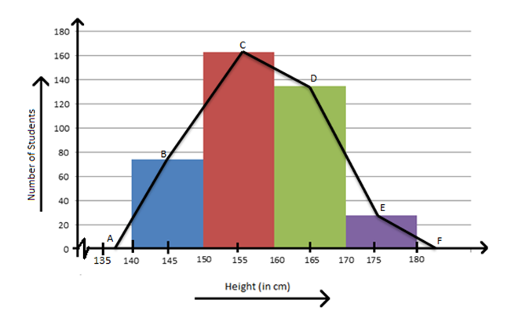
Descriptive Statistics
Frequency Distributions
In tables, the frequency distribution is constructed by summarizing data in terms of the number or frequency of observations in each category, score, or score interval
In graphs, the data can be concisely summarized into bar graphs, histograms, or frequency polygons

Slide 41
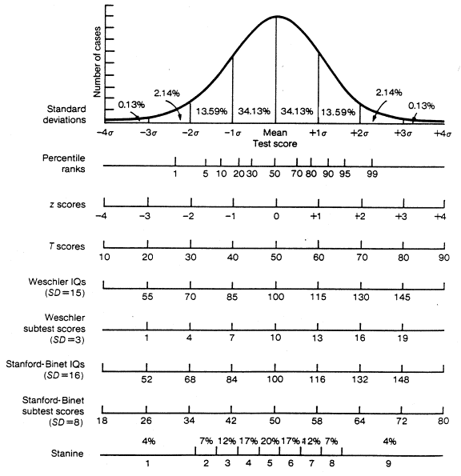

Slide 42
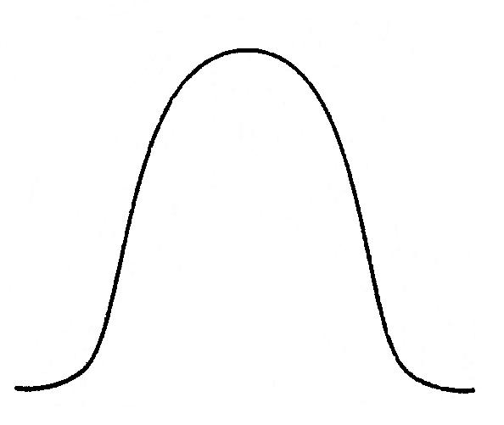
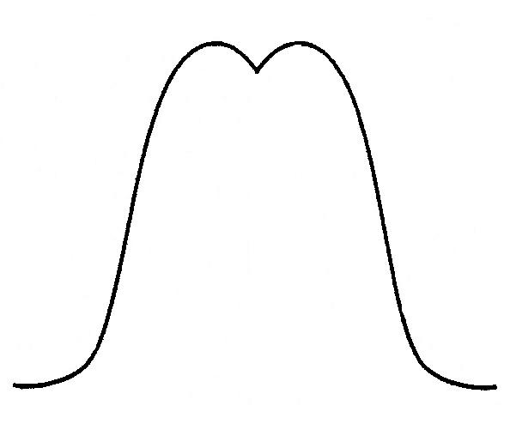
Descriptive Statistics
Normal Curve
Bimodal Curve

Slide 43
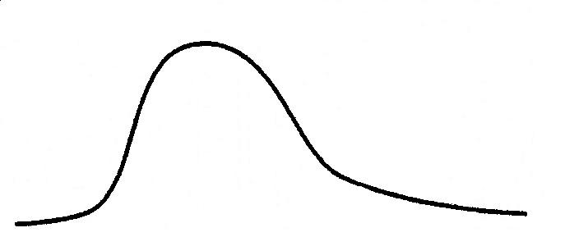
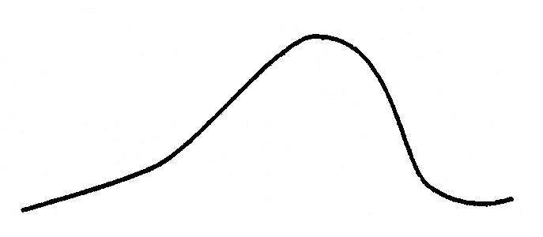
Descriptive Statistics
Positively Skewed
Negatively Skewed

Slide 44
Descriptive Statistics
Measures of Central Tendency
Mode
The most frequently occurring score
3 3 3 4 4 4 5 5 5 6 6 6 6: Mode is 6
3 3 3 4 4 4 5 5 6 6 7 7 8: Mode is 3 and 4
Median
The score that divides a group of scores in half with 50% falling above and 50% falling below the median.
3 3 3 5 8 8 8: The median is 5
3 3 5 6: The median is 4 (Average of two middle numbers)
Mean
Preferred whenever possible and is the only measure of central tendency that is used in advanced statistical calculations:
More reliable and accurate
Better suited to arithmetic calculations
Basically, and average of all scores. Add up all scores and divide by total number of scores.
2 3 4 6 10: Mean is 5 (25/5)

Slide 45
Descriptive Statistics
Measures of Central Tendency
Your Turn!
Mode
Example: 2 3 4 4 4 6 8 9 10 11 11
Median
Example: 2 3 4 4 4 6 8 9 10 11 11
Mean
Example: 2 3 4 4 4 6 8 9 10 11 11

Slide 46
Descriptive Statistics
Measures of Variability (Dispersion)
Range
Calculated by subtracting the lowest score from the highest score.
Used only for Ordinal, Interval, and Ratio scales as the data must be ordered
Example: 2 3 4 6 8 11 24 (Range is 22)
Variance
The extent to which individual scores in a distribution of scores differ from one another
Standard Deviation
The square root of the variance
Most widely used measure to describe the dispersion among a set of observations in a distribution.

Slide 47
Descriptive Statistics
Standard Scores: Z-Scores and T-Scores
Z-Scores
Most widely used standard score in statistics
It is the number of standard deviations above or below the mean.
A Z score of 1.5 means that the score is 1.5 standard deviations above the mean; a Z score of -1.5 means that the score is 1.5 standard deviations below the mean
Always have the same meaning in all distributions
To find a percentile rank, first convert to a Z score and then find percentile rank off a normal-curve table

Slide 48
Descriptive Statistics
Standard Scores: Z-Scores and T-Scores
T-Scores
Most commonly used standard score for reporting performance
May be converted from Z-scores and are always rounded to two figures; therefore, eliminating decimals
Always reported in positive numbers
The mean is always 50 and the standard deviation is always 10.
A T-score of 70 is 2 SDs above the mean
A T-score of 20 is 3 SDs below the mean

Slide 49
Descriptive Statistics
Correlation or Covariation
A correlation coefficient is a statistical summary of the degree or magnitude and direction of the relationship or association between two variables
It is possible to have a negative or positive correlation
Linear Regression
The purpose of a regression equation is to make predictions on a new sample of observations from the findings on a previous sample

Slide 50
Inferential Statistics: Sampling
Sampling relates to the degree to which those surveyed are representative of a specific population
The sample frame is the set of people who have the chance to respond to the survey
A question related to external validity is the degree to which the sample frame corresponds to the population to which the researcher wants to apply the results (Fowler, 1988)

Slide 51
Sampling
Two basic types: probability and non-probability
Probability sampling can include random sampling, stratified random sampling, and cluster sampling
Non-probability sampling can include quota sampling, haphazard sampling, and convenience sampling

Slide 52
Random Sampling
Every unit has an equal chance of selection
Although it is relatively simple, members of specific subgroups may not be included in appropriate proportions

Slide 53
Stratified Random Sampling
The population is grouped according to meaningful characteristics or strata
This method is more likely to reflect the general population, and subgroup analysis is possible
However, it can be time consuming and costly

Slide 54
Systematic Sampling
Every x^{th} unit is selected
(e.g., every other person entering the Swamp at Gate 1 was selected)
The method is convenient and close to random sampling if the starting point is randomly chosen
Recurring patterns can occur and should be examined

Slide 55
Cluster/Multistage Sampling
Natural groups are sampled and then their members are sampled
This method is convenient and can use existing units

Slide 56

Convenience Sampling
This method uses readily available groups or units of individuals
It is practical and easy to use
However, it may produce a biased sample
Convenience sampling can be perfectly
acceptable if the purpose of the research is to test a hypothesis that certain variables are related to one another

Slide 57
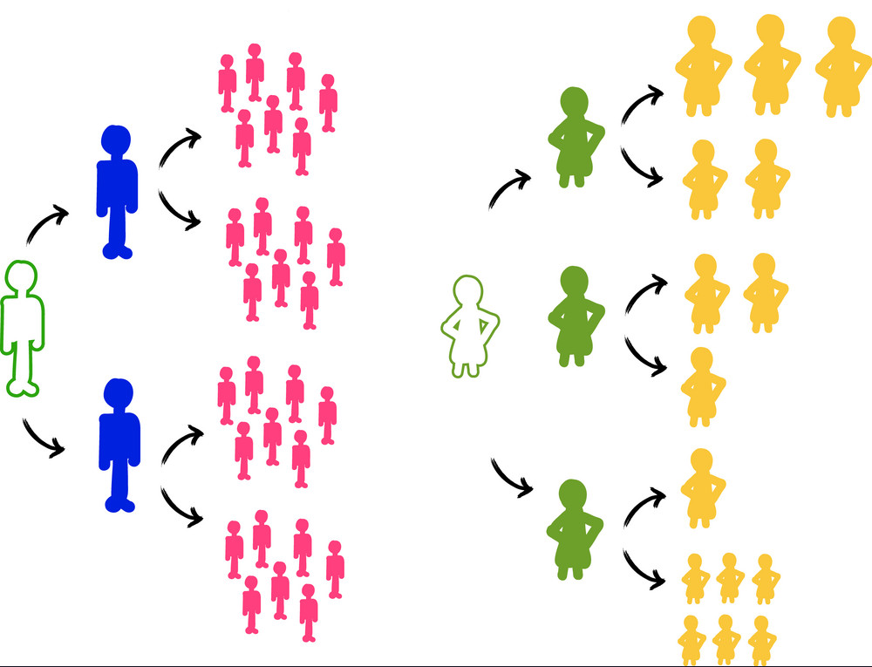
Snowball Sampling
Previously identified members identify others
This method is useful when a list of potential names is difficult to obtain
However, it may produce a biased sample

Slide 58
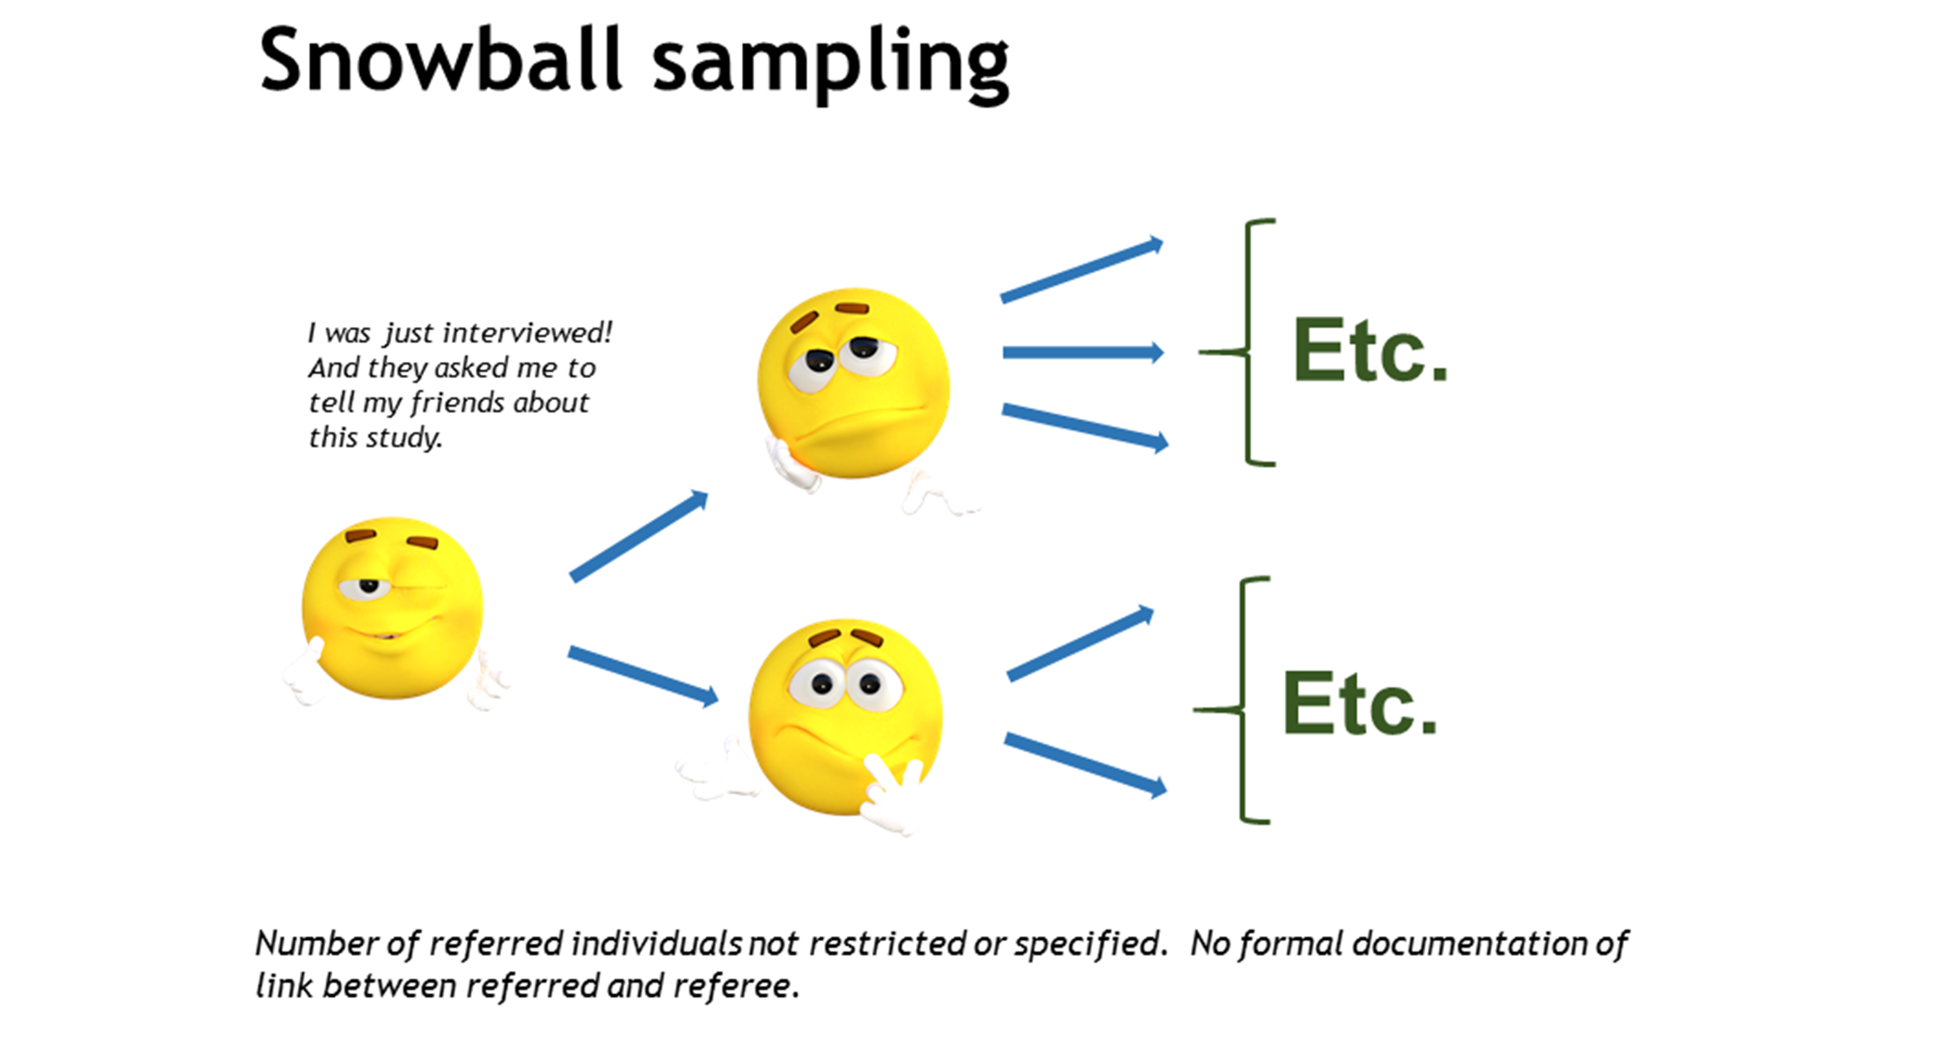

Slide 59
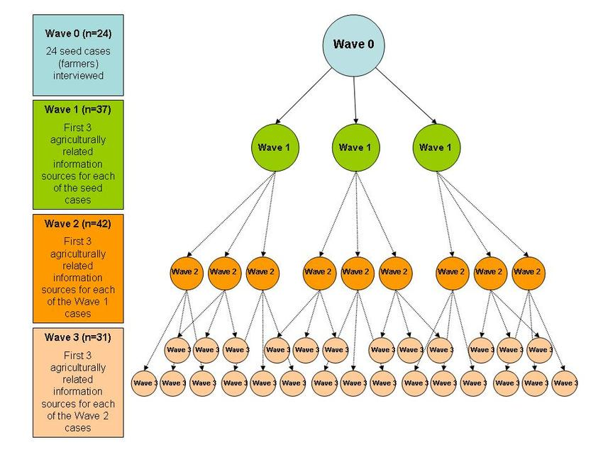

Slide 60
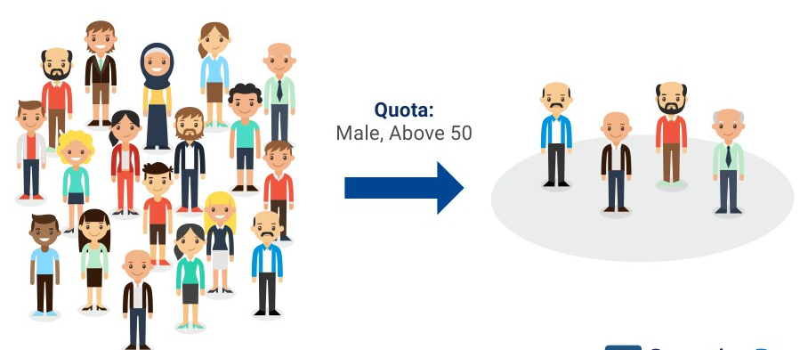
Quota Sampling
The population is divided into subgroups and the sample is selected based on the proportions of the subgroups necessary to represent the population
This method depends on reliable data about the proportions in the population

Slide 61
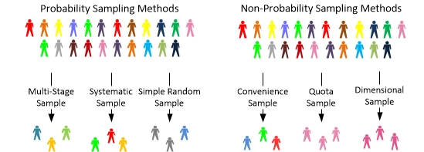
Sampling Methods

Slide 62
Statistics & Parameters
A parameter is a value, usually unknown (and which therefore has to be estimated), used to represent a certain population characteristic. For example, the population mean is a parameter that is often used to indicate the average value of a quantity
A statistic is a quantity that is calculated from a sample of data. It is used to give information about unknown values in the corresponding population. For example, the average of the data in a sample is used to give information about the overall average in the population from which that sample was drawn.

Slide 63
Sampling Distribution
The sampling distribution describes probabilities associated with a statistic when a random sample is drawn from a population

Slide 64
Response Rates
Whatever the sampling technique, response rates and non-response bias must be considered
http://content.apa.org/journals/pro/32/3/248.html
Lowered response rates introduce bias into the sample
In cases of low response rates, people who respond to the survey are likely to be systematically different from people who do not respond to the sample

Slide 65
Response Rates
In mail surveys, the results of non-response bias can be examined by comparing those who respond early with those who respond after follow up
Most government-sponsored surveys require response rates of 75%
For mail surveys, post-cards, follow-up letters, and telephone calls are used to increase the response rates (Fowler, 1988)
According to Babbie (1989), a response rate of 70% is very good, 60% is good, and 50% is adequate

Slide 66
Inferential Statistics
Interval Estimate
A range or band within which the parameter is thought to lie, instead of a single point or value as the estimate of the parameter

Slide 67
Inferential Statistics
Sampling Distributions
The sampling distribution of the mean is a frequency distribution, not of observations, but of means of samples, each based on n observations.
The standard error of the mean is used as an estimate of the magnitude of sampling error. It is the standard deviation of the sampling distribution of the sample means.

Slide 68
Inferential Statistics
Confidence Intervals
Same as the percentage of cases in a normal distribution that lie within 1, 2, or 3 standard deviations from the mean
Central Limit Theorem
States that the distribution of samples (means, medians, variances, and most other statistical measures) approaches a normal distribution as the sample size, n, increases
Hypothesis Testing – will cover next.

Slide 69
Inferential Statistics
Types of Statistical Analysis - Descriptive
Quantify the degree of relationship between variables
Parametric tests are used to test hypotheses with stringent assumptions about observations
e.g., t-test, ANOVA
Nonparametric tests are used with data in a nominal or ordinal scale
e.g., Chi-Square, Mann-Whitney U, Wilcoxon

Slide 70
Inferential Statistics
Types of Statistical Analysis - Inferential
Allow generalization about populations using data from samples
Non-parametric
Non-parametric tests do not require any assumptions about normal distribution, but are generally less sensitive than parametric tests.
The test for nominal data is the Chi-Square test
The tests for ordinal data are the Kolmogorov-Smirnov test, the Mann-Whitney U test, and the Wilcoxon Matched-Pairs Signed-Ranks test
Parametric
The tests for interval and ratio data include the t-test, ANOVA, ANCOVA, and Post-Hoc ANOVA tests

Slide 71
Role of Statistics in Research

Slide 72
Role of Statistics in research
Validity Will this study help answer the research question?
Analysis What analysis, & how should this be interpreted and reported?
Efficiency Is the experiment the correct size, making best use of resources?
Notes:
Give examples of each

Slide 73
Validity Will the study answer the research question?
Surveys
select a sample from a population
describe, but can’t explain
can identify relationships, but can’t establish causality

Slide 74
Surveys & Causality PGRM 2.2.1
In a survey: farm income increased by 10% for each increase in fertiliser of 30 kg/ha
Is this relationship causal?

Slide 75
Surveys & Causality PGRM 2.2.1
In a survey: farm income increased by 10% for each increase in fertiliser of 30 kg/ha
Is this relationship causal?
Not necessarily, other factors are involved: Managerial ability Farm size Educational level of farmer
Fertiliser level may be related to these other possible causes, and may (or may not) be a cause itself

Slide 76
Survey Unit
Example: In an survey to assess whether Herefords have a higher level of calving difficulty than Friesians, the individual cow is the survey unit.

Slide 77
Survey Unit
Example: In a survey to assess the height of Irish males vs English males, the unit is the individual male in that one would sample a number of males of each country and take their heights rather than measure one male from each country many times.

Slide 78
Designed Experiments

Slide 79
Comparing treatment effect
Effect = difference between treatments
A well designed experiment leads to conclusion:
Either the treatments have produced the observed effect
or
An improbable (chance < 1:20, 1:100 etc) event has occurred
Technically we calculate a p-value of the data: i.e. the probability of obtaining an effect as large as that observed when in fact the average effect is zero

Slide 80
Essential elements of a designed experiment
Notes:
Effect of increased CO2 – the different levels are the treatments
Units treated in the same way differ! – so what is observed may be due by chance to an exceptional set of units being involved
Ask – how would you do this eg in groing plants in small seed trays (30available to compare 3 treatments)

Slide 81
Essential elements of a designed experiment
COMPARATIVE The objective is to compare a number (>1) of treatments
REPLICATION Each treatment is tested on more than one experimental unit
RANDOMISATION experimental units are allocated to treatments at random
Notes:
Effect of increased CO2 – the different levels are the treatments
Units treated in the same way differ! – so what is observed may be due by chance to an exceptional set of units being involved
Ask – how would you do this eg in groing plants in small seed trays (30available to compare 3 treatments)

Slide 82
Replication
Each treatment is tested on more than one experimental unit (the population item that receives the treatment)
To compare treatments we need to know the inherent variability of units receiving the same treatment
background noise
this might be a sufficient explanation for the observed differences between treatments

Slide 83
Replication: 2 facts
Our faith in treatment means will:
Increase with greater replication
Decrease when noise increases
In particular the standard error of difference (SED) between 2 treatment means where: r = (common) replication; s = typical difference between observations from same treatment:
SED is the typical difference between 2 treatment means where the treatments don’t differ

Slide 84
Validity & Efficiency
Validity: The first requirement of an experiment is that it be valid. Otherwise it is at best a waste of time and resources and at worst it is misleading.
Efficiency: the use of experimental resources to get the most precise answer to the question being asked, is not an absolute requirement but is certainly desirable because cost is an important aspect of any experiment.

Slide 85
Pseudoreplication - how to invalidate your experiment!
Treating multiple measurements on the same unit as if they were measurements on independent units
See PGRM Examples 1 – 3 pg 2-5
Notes:
Discussion

Slide 86
Pseudoreplication
Example: In an experiment testing the effect of a hormone treatment on follicle development, the cow is the experimental unit, not the follicle.

Slide 87
Example:
In an experiment to compare three cultivars of grass, a rectangular tray was assigned at random to each treatment. Trays were filled with John Innes Number 2 compost and 54 seedlings of the appropriate cultivar were planted in a rectangular pattern in each tray.
After ten weeks the 28 central plants were harvested, dried and weighed and the 84 plant weights recorded. What was the experimental unit?

Slide 88
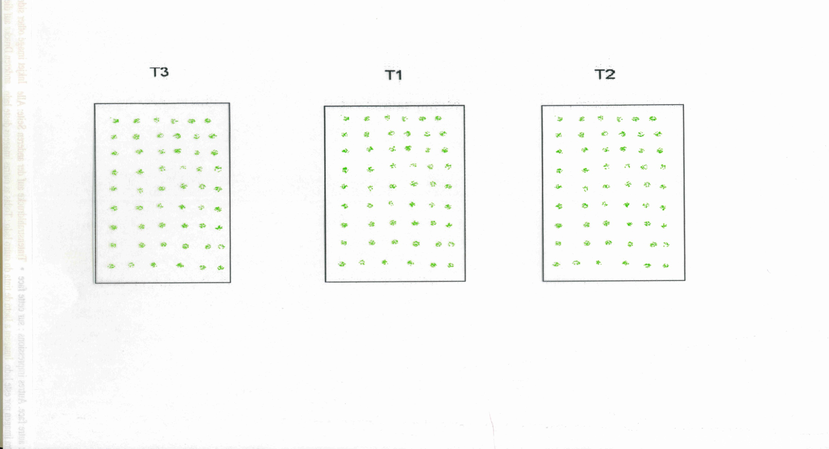

Slide 89
Example:
In an experiment to compare three cultivars of grass, 7 square pots were assigned at random to each treatment. Pots were filled with John Innes number 2 compost and 16 seedlings of the appropriate cultivar planted in a square pattern in each pot.
After ten weeks the 4 central plants were harvested, dried and weighed. Thus 84 plant weights were recorded. What is the experimental unit and what should be analysed?

Slide 90
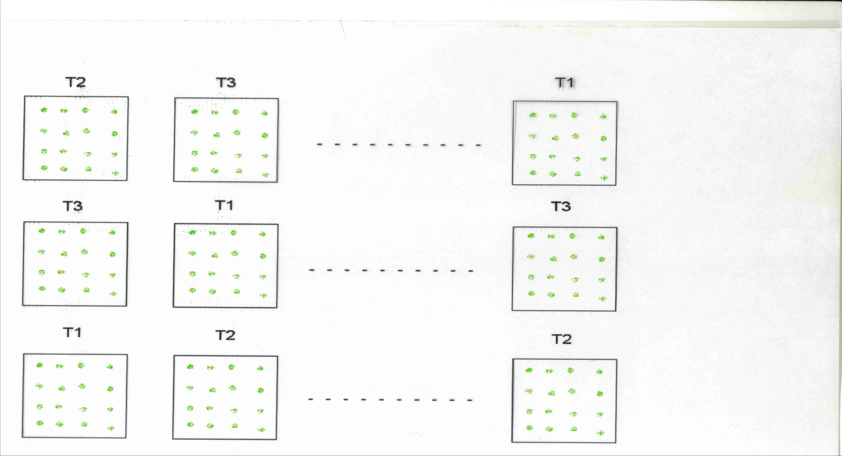

Slide 91
Randomisation - allocating treatments to units
Ensures the only systematic force working on experimental units is that produced by the treatments
All other factor that might affect the outcome are randomly allocated across the treatments

Slide 92
Randomisation - how it works
What do we mean by ‘In a randomised experiment any difference between the mean response on different treatments is due to treatment difference or random variation or both’?

Slide 96
Three points:
The observed treatment difference is due only to treatment effect and variation.
If the treatment effect is large relative to the background noise then even an extreme allocation will not obscure the treatment effect. (Signal/Noise ratio).
If the number of experimental units is large then a treatment effect will usually be more obvious, since an extreme allocation of experimental units is less likely. With 20 experimental units, unlikely that the 10 worst and the 10 best allocated to different treatments.

Slide 97
Defective Designs
PGRM pg 2-8 Examples 1 – 7

Slide 98
Tests of Hypotheses - Tests of Significance
Survey: Are the observed differences between groups compatible with a view that there are no differences between the populations from which the samples of values are drawn?
Designed experiments: Are observed differences between treatment means compatible with a view that there are no differences between treatments?

Slide 99
Tests of Hypotheses - Tests of Significance
Designed experiment - only two explanations for a negative answer, difference is due to the applied treatments or a chance effect
Survey is silent in distinguishing between various possible causes for the difference, merely noting that it exists.

Slide 100
Example
An experiment on artificially raised salmon compared two treatments and 20 fish per treatment. Average gains (g) over the experimental period were 1210 and 1320. Variation between fish within a group was RSE = 135g
Did treatment improve growth rate?

Slide 101
Procedure
a) NULL HYPOTHESIS Treatments have no effect and any difference observed between groups treated differently is due to chance (variation in the experimental material)'
b) Measure
-the variation between groups treated differently
-the variation expected if due solely to chance
c) TEST STATISTIC Compare the two measures of variation. Do treatments produce a 'large' effect?

Slide 102
d) The observed difference could have occurred by chance. Statistical theory gives rules to determine how likely a given difference in variation is liable to be by chance.
e) SIGNIFICANCE TEST Face the choice.
-This difference in variation could have occurred by chance with probability ? (5%, 1%, etc)
OR
-There is a real difference (produced by treatment).
f) GOOD EXPERIMENTAL PROCEDURE makes sure in experiments that there is no other possible explanation.

Slide 103
Example: - The t test
An experiment on artificially raised salmon compared two treatments and 20 fish per treatment. Average gains (g) over the experimental period were 1210 and 1320. Variation between fish within a group was RSE = 135g
Did treatment improve growth rate?

Slide 104
Example
a) NULL HYPOTHESIS - Treatment does not affect salmon growth rate
b) Observed difference between groups
1320 - 1210 = 110
Variation expected solely from chance
135 x (2/20).5 = 42.7
c) Test Statistic
t = 110/42.7 = 2.58
d) Statistical theory (t tables) shows that the chance of a value as large as 2.58 is about 1 in 100
e) Make the choice
f) Are there other possible explanations?

